Slide 1



HEALTHCARE
STROKE PREDICTION

Slide 2


INSTRUCTOR YONG ZHENG
MEMBERS
ANKIT PATIL A20451742

Slide 3
AGENDA
INTRODUCTION
RESEACH MOTIVE
ALL ABOUT OUR DATA
PROBLEMS WE CRAKED
SOLUTION WE PERFORMED
MODELS USED
OUR FINDINGS
CONCLUSION
IMPROVEMENT SCOPE

Slide 4

INTRODUCTION

Slide 5
HEALTHCARE STROKE DATASET
We have considered symptoms like Hypertension, Heart Diseases, Ever experienced stroke and few parameters like:
Age
Gender
Marital Status
Work Type
BMI
Smoking Status
Glucose Level
Residence Type

Slide 6

SOFTWARE R Studio
LIBRARIES
library(class)
library(caret)
library(dummies)
library(plyr)

Slide 7

RESEARCH MOTIVE

Slide 8
ALL ABOUT OUR DATA

Slide 9
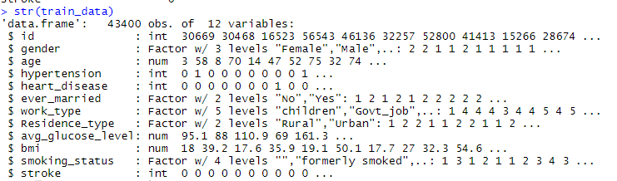
DATA SET
NUMERICAL
Id
Age
Hypertension
Heart Diseases
Avg Glucose Level
BMI
Stroke
CATEGORIAL
Gender
Ever married
Work Type
Residence Type
Smoking Status

Slide 10

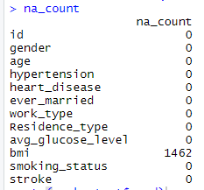

Missing value & Blank Column
Function To check missing value in the column

Slide 11
DATA PREPROCESSING

Slide 12


Replacing Missing Value with Mean

Slide 13

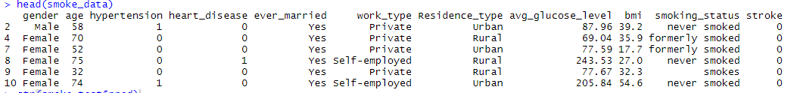
Eliminating ID Column

Slide 14

For Visualization Converting IT INTO YES/NO

Slide 15

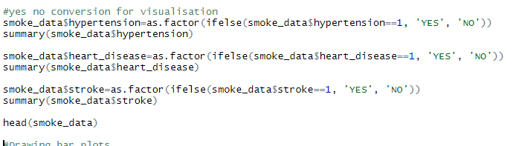
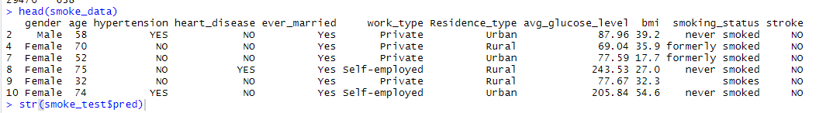

Slide 16

Dealing with Numerical Variable

Slide 17

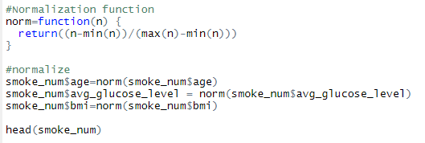
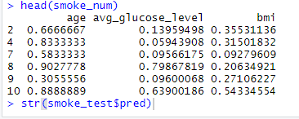
Normalizing Numerical Data

Slide 18

CATEGORICAL DATA

Slide 19

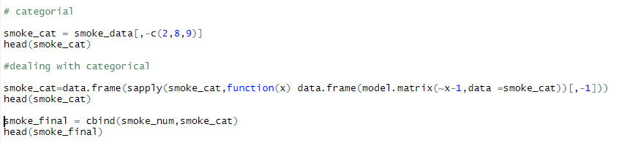
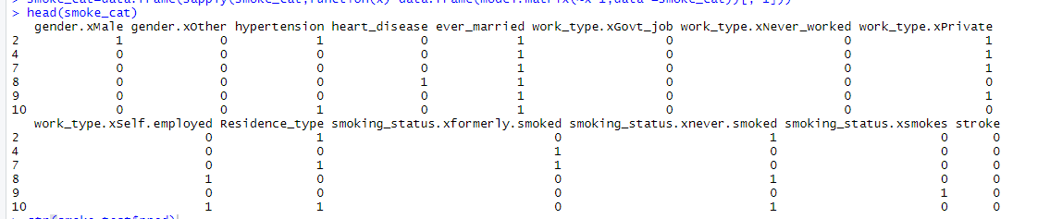

Slide 20
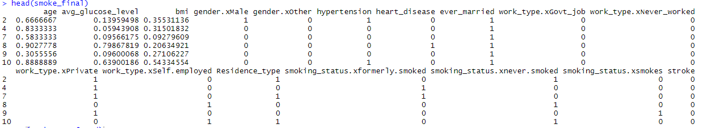
BINDING WHOLE DATA

Slide 21
BAR PLOTS

Slide 22
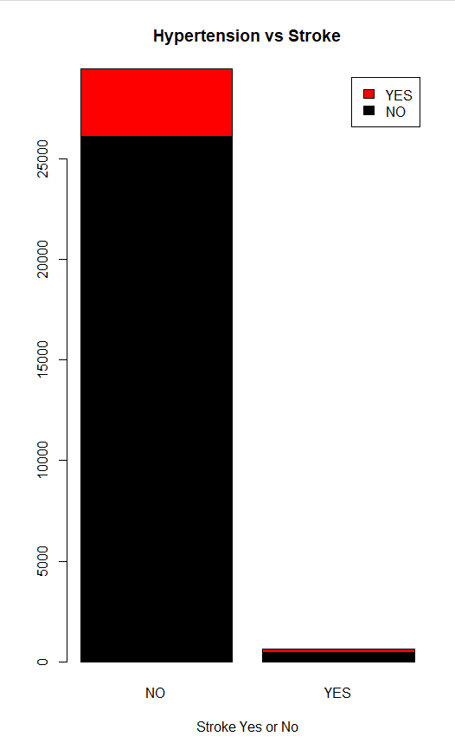
HYPERTENSION VS STROKE
The graph here shows that the number of patients suffering or not suffering from hypertension may or may not have heart strokes.

Slide 23
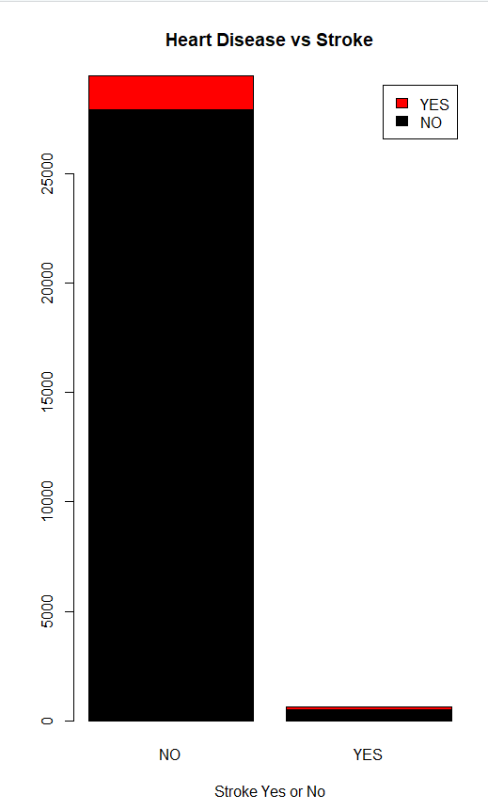
HEART DISEASES VS STROKE
The graph here shows that the number of patients suffering or not suffering from heart disease may or may not have heart strokes.

Slide 24
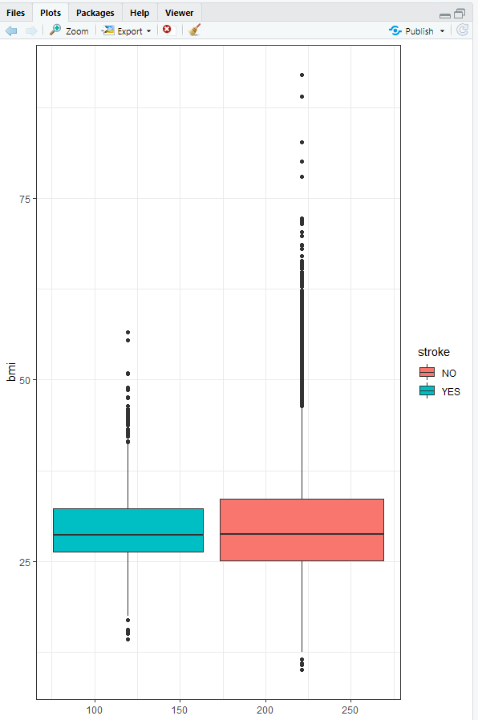
ANOVA PLOT
We draw box plot to show the difference between group means.
ANOVA F-test
H0: µ1 = µ2= µ3= … µk all the means are equal.
H1: not all the means are equal.

Slide 25
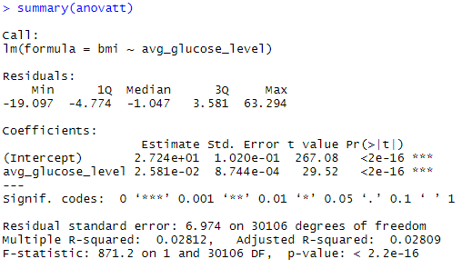
ANOVA Hypothesis

Slide 26
MODELS

Slide 27
KNN Classification

Slide 28


KNN Model

Slide 29
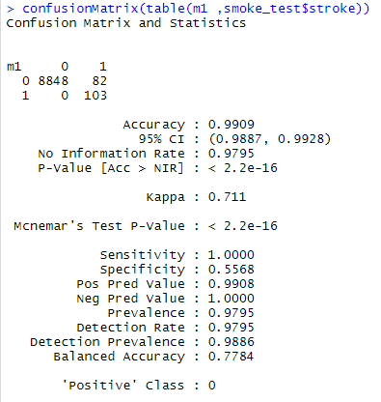
CONFUSION MATRIX

Slide 30
LOGISTIC Regression

Slide 31

Hold out evaluation Split the data in Training & Test

Slide 32

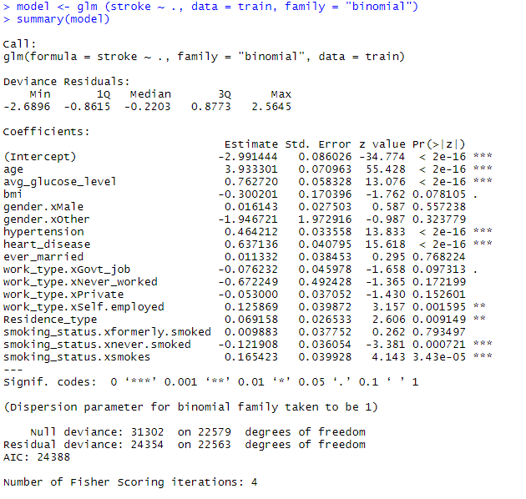
Logistic Regression Model

Slide 33

Predicting Stroke

Slide 34
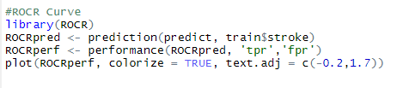
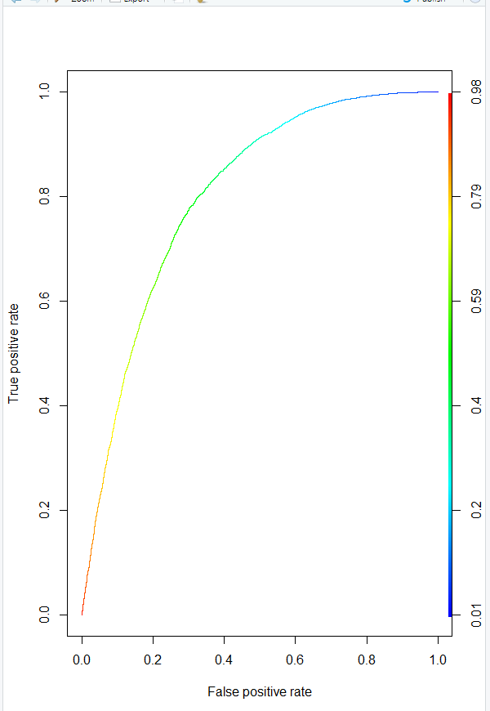
ROC

Slide 35
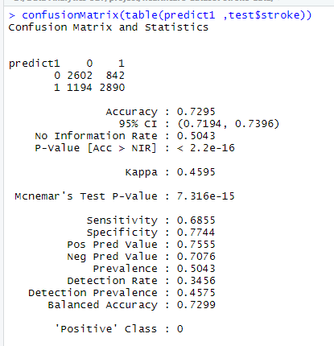
CONFUSION MATRIX

Slide 36
CONCLUSION
1. We have used KNN and logistic regression model to predict heart strokes.
2. The accuracy of KNN is 99% whereas, Logistic model shows 72% accuracy.
3. Therefore, KNN model is better in predicting heart strokes.

Slide 37
INPROVEMENT SCOPE
1. We can analyze the data using different models such as Naïve Bayes and Trees to predict our data outcomes, also to test the accuracy of each model.
2. We can consider more parameters like family history of strokes, alcohol consumption, etc. to predict heart strokes.

Slide 38


